Slide 1
Second Level Technologies
Benchmark TCH 2-20a
Physics of Flight Pt 7
Exploring the science and technology of flight control
and testing the theory
with paper models.

Slide 2
We have looked at how aerofoils can be used to develop lift and how these aerofoils can be fitted to an aircraft to achieve stable flight.
However, so far, our aerodynamically stable aircraft can only fly downhill in a straight line at a fixed speed.

Slide 3
Now we have to understand how aircraft can be controlled in flight so that the pilot can control the direction and the speed of the flight.
Notes:
Some of the early designers of aircraft gave no thought as to how their aircraft would be controlled. The rich people who were the ones that had time to think about such things were used to having a coachman who would look after these problems and so they assumed that they would hire a man who would know what to do. However, of course, it would not be as simple as that and others knew that much more thought would have to be given to the subject.

Slide 4
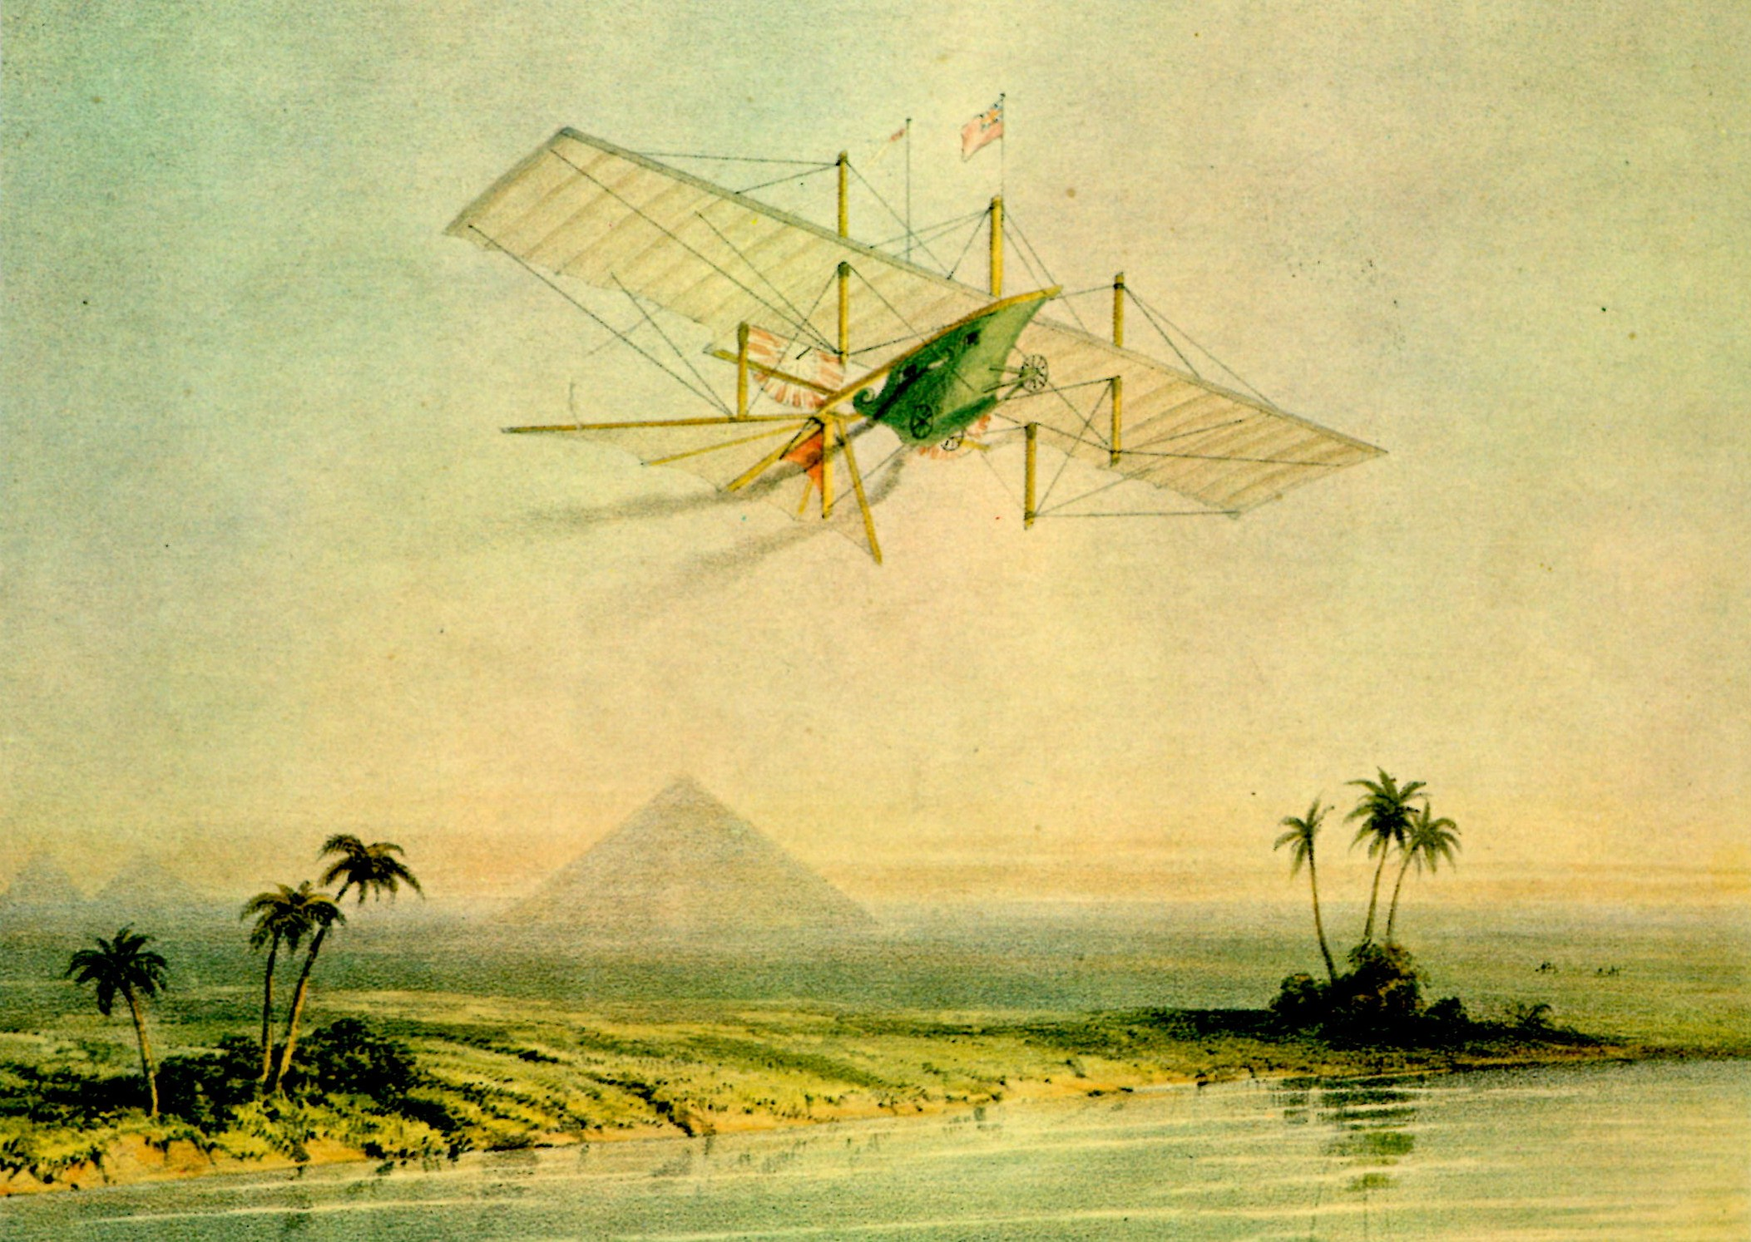
Henson’s Steam Powered Aerial Carriage, 1843.
Notes:
Here is Henson’s steam powered aerial carriage cruising down the Nile in 1843 and...

Slide 5
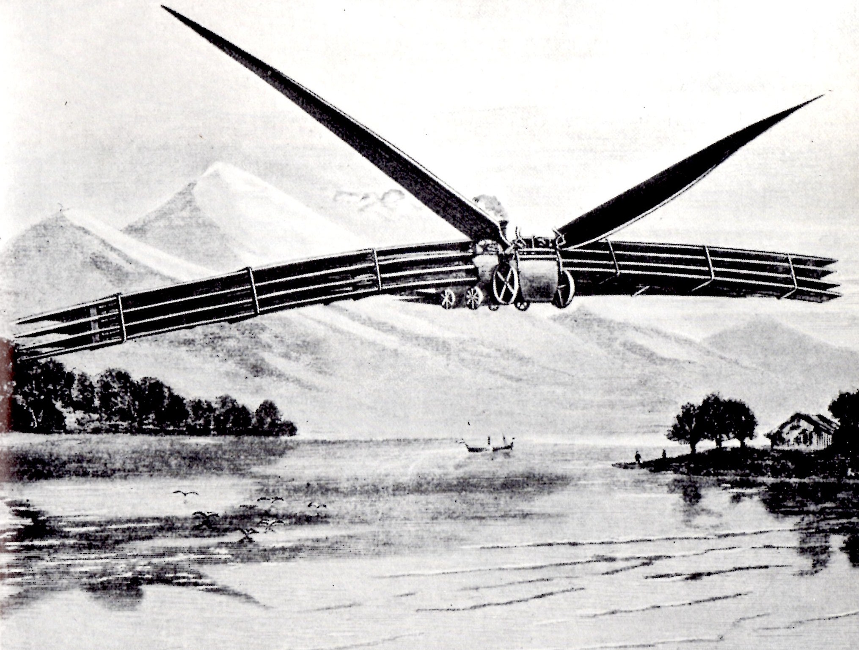
The Kaufmann Aerial Steam Carriage, 1868
Notes:
….the Kaufmann Aerial Steam Carriage in 1868 seen in a equally exotic location with no obvious method of control.
The fanciful aircraft shown in these two images were, unsurprisingly, never built. Do you think they would have been able to fly if they had been built? If not, why not? (Impracticability of steam engines – weight, need to carry and burn coal, need to carry water, control etc etc)

Slide 6
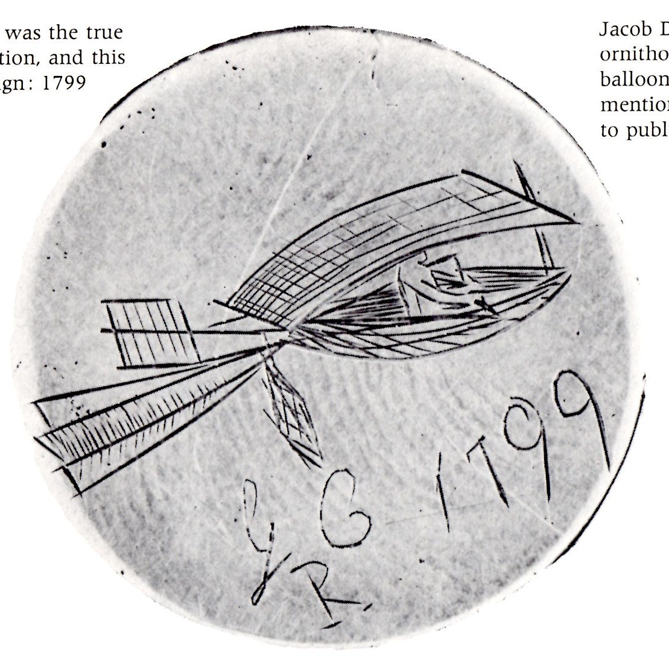
Notes:
In the year 1799, Sir George Cayley, proposed that a man-carrying aircraft should have three main elements. A body, to carry the pilot, a wing to produce lift and a tail to balance and steer the aircraft. He, of course, was quite right although it is not quite clear how he came to that conclusion.

Slide 7
Sir George Cayley’s
Governable Parachute of 1852
Note the use control cables to alter the angle of the tail unit in flight.
Notes:
In 1849 Cayley demonstrated that his design did work by launching a full size version of his aircraft down a hill carrying his coachman as the pilot. It is doubtful whether the coachman was ever in control of the aircraft but he did survive, and immediately resigned his post with Sir George.
In 1852 Cayley went on to publish a design for his optimum aircraft which he called a “Governable Parachute” and went on to have an interest in many things and even considered how best to design a helicopter.
Show the video at http://www.bbc.co.uk/education/clips/zs2xpv4

Slide 8
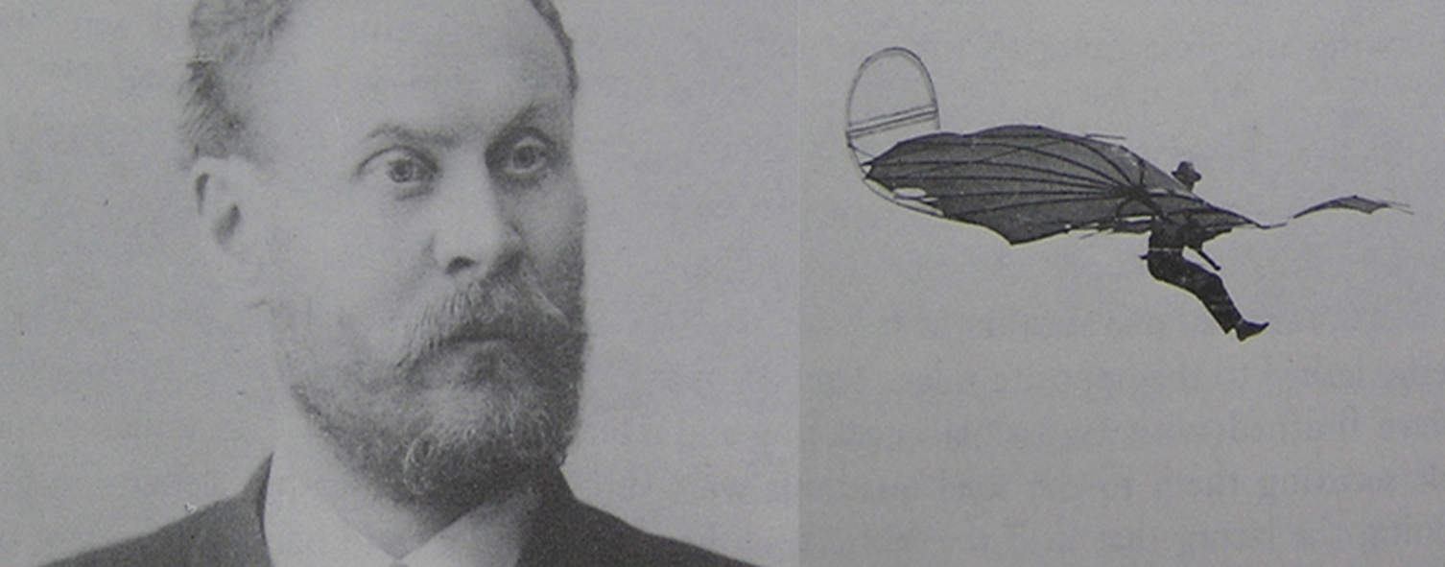
German Engineer, Otto Lillienthal, and flying one of his gliders in 1894
Notes:
However it would be another 40 years before a truly successful man-carrying glider appeared. The German engineer Otto Lillienthal built and successfully flew many versions of his aircraft. Lillienthal realised that flight control would be required and he was experimenting with moving flight control surfaces when he lost control of the aircraft and crashed. He died the next day from the effects of a broken spine.

Slide 9
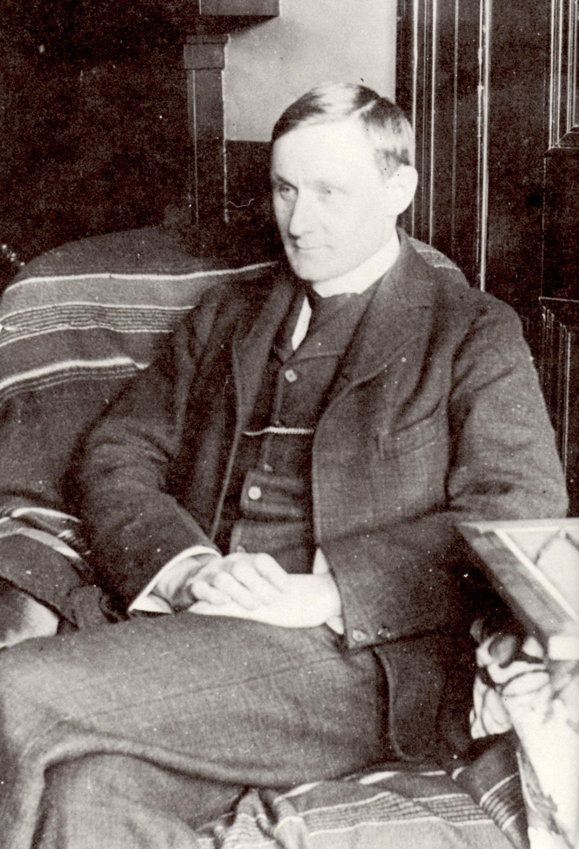
Percy Pilcher
1866 – 1899
Notes:
Percy Pilcher built and flew two successful gliders, the Bat and the Hawk but neither glider had a flight control system. To control his aircraft he relied entirely on weight shift control achieved by moving his body around the change the balance of the aircraft. This type of “weight shift” control did work but only if the pilot was about three times heavier than the aircraft.
If aviation had developed along these lines then aircraft would not have grown any bigger or heavier. This was obviously not the way to go to develop the control of aircraft. In fact, although modern versions of these pioneering aircraft have more efficient wings, they are still no bigger or heavier than Percy Pilcher’s Bat.

Slide 10
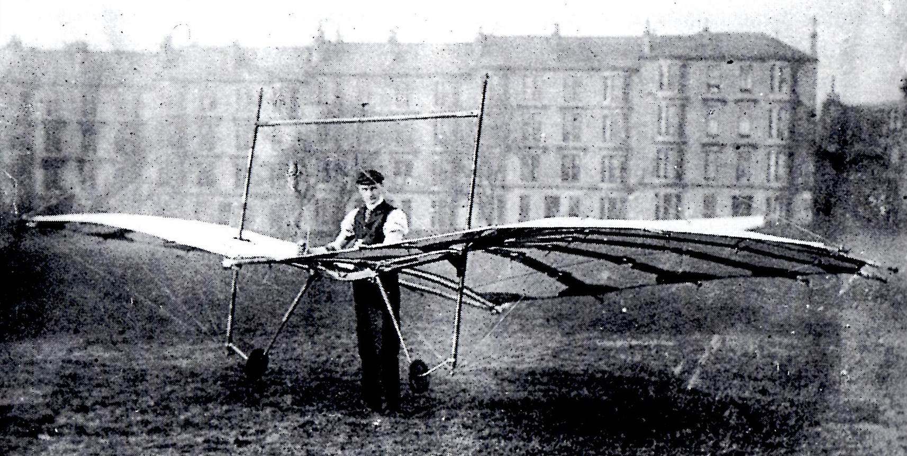
Notes:
This photo shows Percy Pilcher and his Hawk glider on Glasgow University playing fields just before he moved back to England to fly it there. This actual aircraft still exists and is on display in the National Museum of Scotland in Edinburgh. The Hawk is the oldest surviving aircraft in Britain.

Slide 11
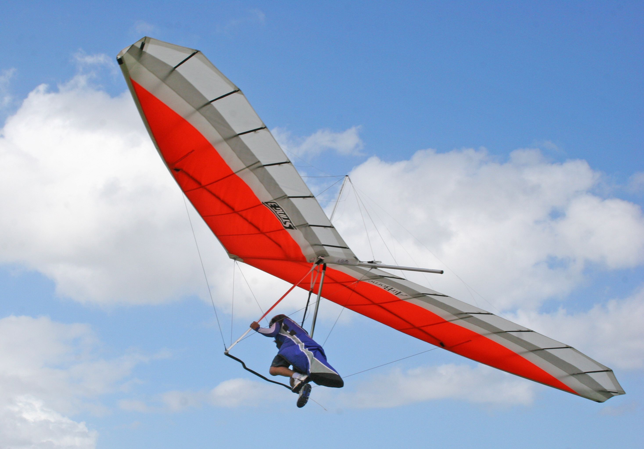
A modern hang glider
Notes:
“Weight shift” control, as used by Lillienthal and Pilcher did work but only if the pilot was about three times heavier than the aircraft.
Here is a modern hang glider controlled in the same way as Pilcher’s Bat. This method of “weight shift” flight control is very simple but not very effective and means that even the latest hang gliders are still no bigger or heavier than Pilcher’s Bat.
If aviation had developed along these lines then aircraft would not have grown in size. This was clearly not the way to go to develop useful aircraft.
A much better way of controlling aircraft would be needed.

Slide 12
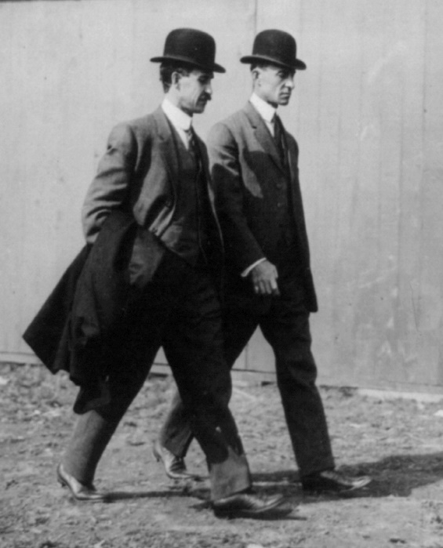
This is the Wright brothers, Orville and Wilbur, smartly dressed on their way to a meeting in 1910.
Notes:
The American Wright brothers owned a bicycle shop in Dayton Ohio where they designed and built bikes. As a result they were good engineers but also importantly, they were very methodical. They started their flight experiments like other pioneers by building gliders in 1899. The various versions of the gliders proved that the wings would be able to support the weight of the aircraft and pilot but they knew that some means of control would have to be designed to make the aircraft a practical means of transport.

Slide 13
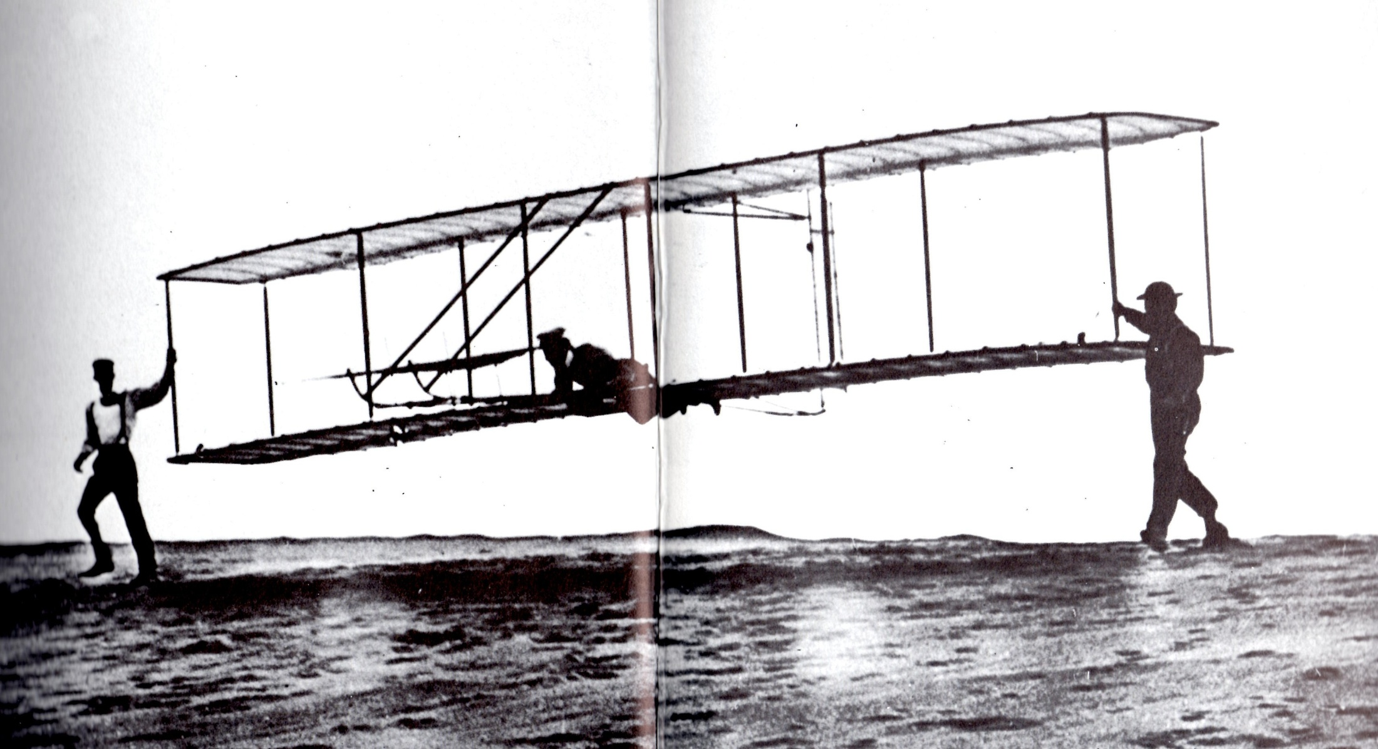
Notes:
This is the last of the test gliders built and flown by the American Wright brothers in 1902. This glider had full three axis control. Note the control surface at the front that could be moved to control pitching nose up and nose down. The rudder at the back could be moved to yaw the aircraft left and right and, most importantly, the outer wing panels could be twisted slightly to unbalance the lift forces and this rolled the aircraft left wing down or right wing down. The Wright brothers discovered that this roll control was powerful and could easily steer the aircraft in any direction. Because the Wright brothers were familiar with bikes they knew that when a bike is standing still and has no rider, it is completely unstable i.e it will not stand on its own. However if a rider sits on the bike and travells forwards, the rider could quite quickly learn to control the bike and ride it safely. They reasoned that if an aircraft was designed to be unstable then it would be easier to control it in flight.
It is interesting to note that modern fighter aircraft are designed in the same way to make them more agile when in combat. These aircraft are so unstable that they no longer can be flown by pilots and need high powered fast computers to operate the flight controls.
Having solved the control problem the next stage was to power the aircraft.

Slide 14
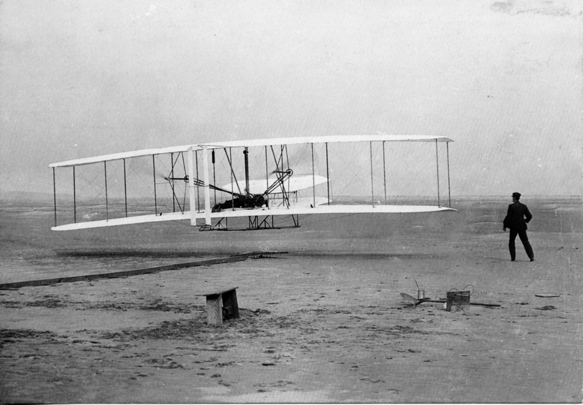
The Wright Brothers first powered flight. 17th December 1903.
Notes:
While the brothers were experimenting with the control of their gliders they also designed and built a 12 horsepower engine which they calculated would drive two large propellers and develop about 90 pounds of thrust.
The engine and propellers were mounted in the latest version of their gliders and they called the aircraft the Flier 1.
And so it was that on the 17th of December 1903, the Flier 1 was the first powered aircraft in the world to take-off and fly under control of the pilot.
The first flight only lasted 12 seconds but the fourth flight, later on the same day, lasted 59 seconds with the aircraft travelling a distance of about half a mile through the air.
The Wright brothers seemed to have solved the problem of controlled flight.
Later, as they became more experienced pilots and improved the aircraft, they were able to demonstrate complete control in flight. When they came across the Atlantic to show off their aircraft, the European flight pioneers were amazed.

Slide 15
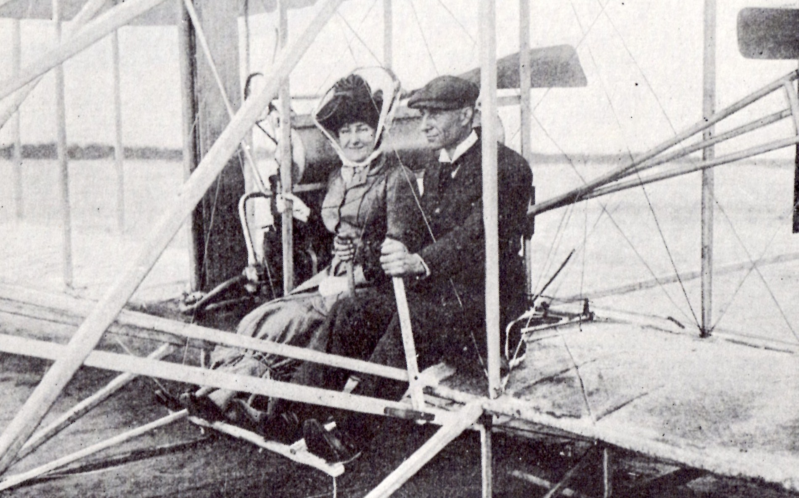
Notes:
When the Brothers flew their gliders and Flyer 1 aircraft they lay in their stomachs to operate the controls but they soon realised that they would have better control if they sat upright in a proper seat. Here is Orville Wright sitting in the new position upright with the elevator control in his left hand and the wing warping and rudder control stick in his right hand. This lady passenger is about to go for a flight. Notice that her hat and skirt seemed to be securely fastened.

Slide 16
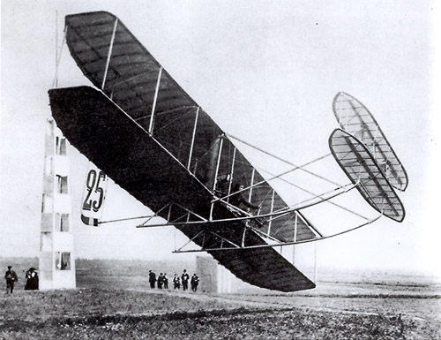
Notes:
The Wright brothers aircraft were built under licence in Britain and France and many pilots were able to learn to fly the aircraft. In 1909 at Reims in France, an air race was held with all the latest European aircraft competing. This photo of the French pilot Lefebvre flying a French built Wright biplane, shows just how accurately the aircraft could be flown close to the ground as it rounded one of the course marker pylons.

Slide 17
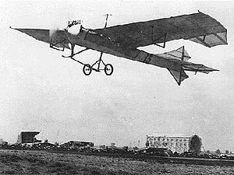
Notes:
However, despite the success of the Wright brothers aircraft, the European aircraft designers decided that the future of flight lay with aircraft that had some inherent stability to make flight control less demanding for pilots. They were worried that having an unstable aircraft that had to be flown constantly by the pilot would cause many aircraft to crash due to a combination of tiredness or distraction of the pilot. So the design of aircraft control systems started down another route.
The Europeans, particularly the French, aircraft designers devised various ways to make aircraft more stable. The trick was to find a level of stability that would make the aircraft relatively easy to fly but not so stable that it could not be manoeuvred in flight.
The answer seemed to be to have fixed stabilising surfaces that could also be altered in flight to change their aerodynamic shape. The modern flight control surface was born. The photo shows the influential Antionette aircraft of 1909 designed by the French aviator Levavaseur. The aircraft was fitted with flight control surfaces to be able to pitch, roll and yaw the aircraft.

Slide 18
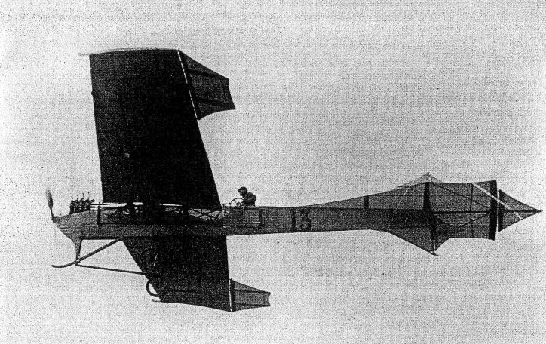
Notes:
This photo shows the Antoinette aircraft again and shows the relatively simple ailerons at the wing tips. The vertical and horizontal stabilising surfaces, with rudder and elevator, were mounted at the rear of the fuselage in a tail unit.
The other important change was to angle the wings slightly up towards the tips since it was found that this angle, now called the dihedral angle, gave the aircraft stability both laterally and directionally.
At first the stabilising and moving control surfaces were relatively crude flat structures but as aircraft increased in speed and weight these structures became symmetrical aerofoils shapes which were much more efficient.
Another important change was to rearrange the pilot’s controls so that the roll and pitch control was effected by a central control column and the yaw control was effected by a foot-operated rudder bar. These early aircraft set the standard of aircraft control layout that is used on the greatest majority of aircraft to this day.

Slide 19
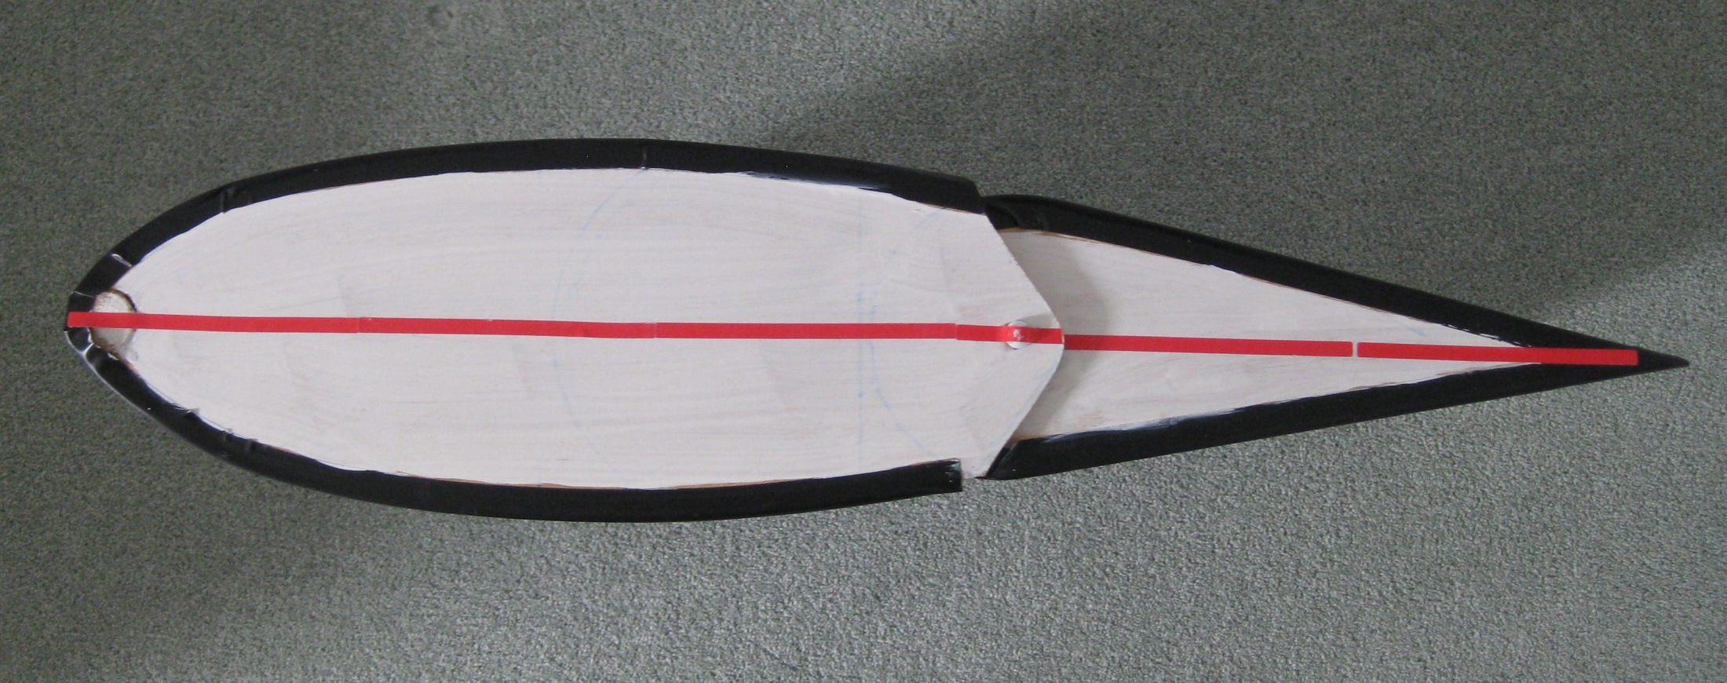
Notes:
Most modern combined stabiliser and control surface aerofoil sections look something like this. The forward section is fixed to the aircraft structure and the rear hinged section can be adjusted by the pilot. Note that the section has no camber, the red centreline is a straight line.
This section can be used for the horizontal and vertical stabilisers and in a slightly different form on the wing.

Slide 20
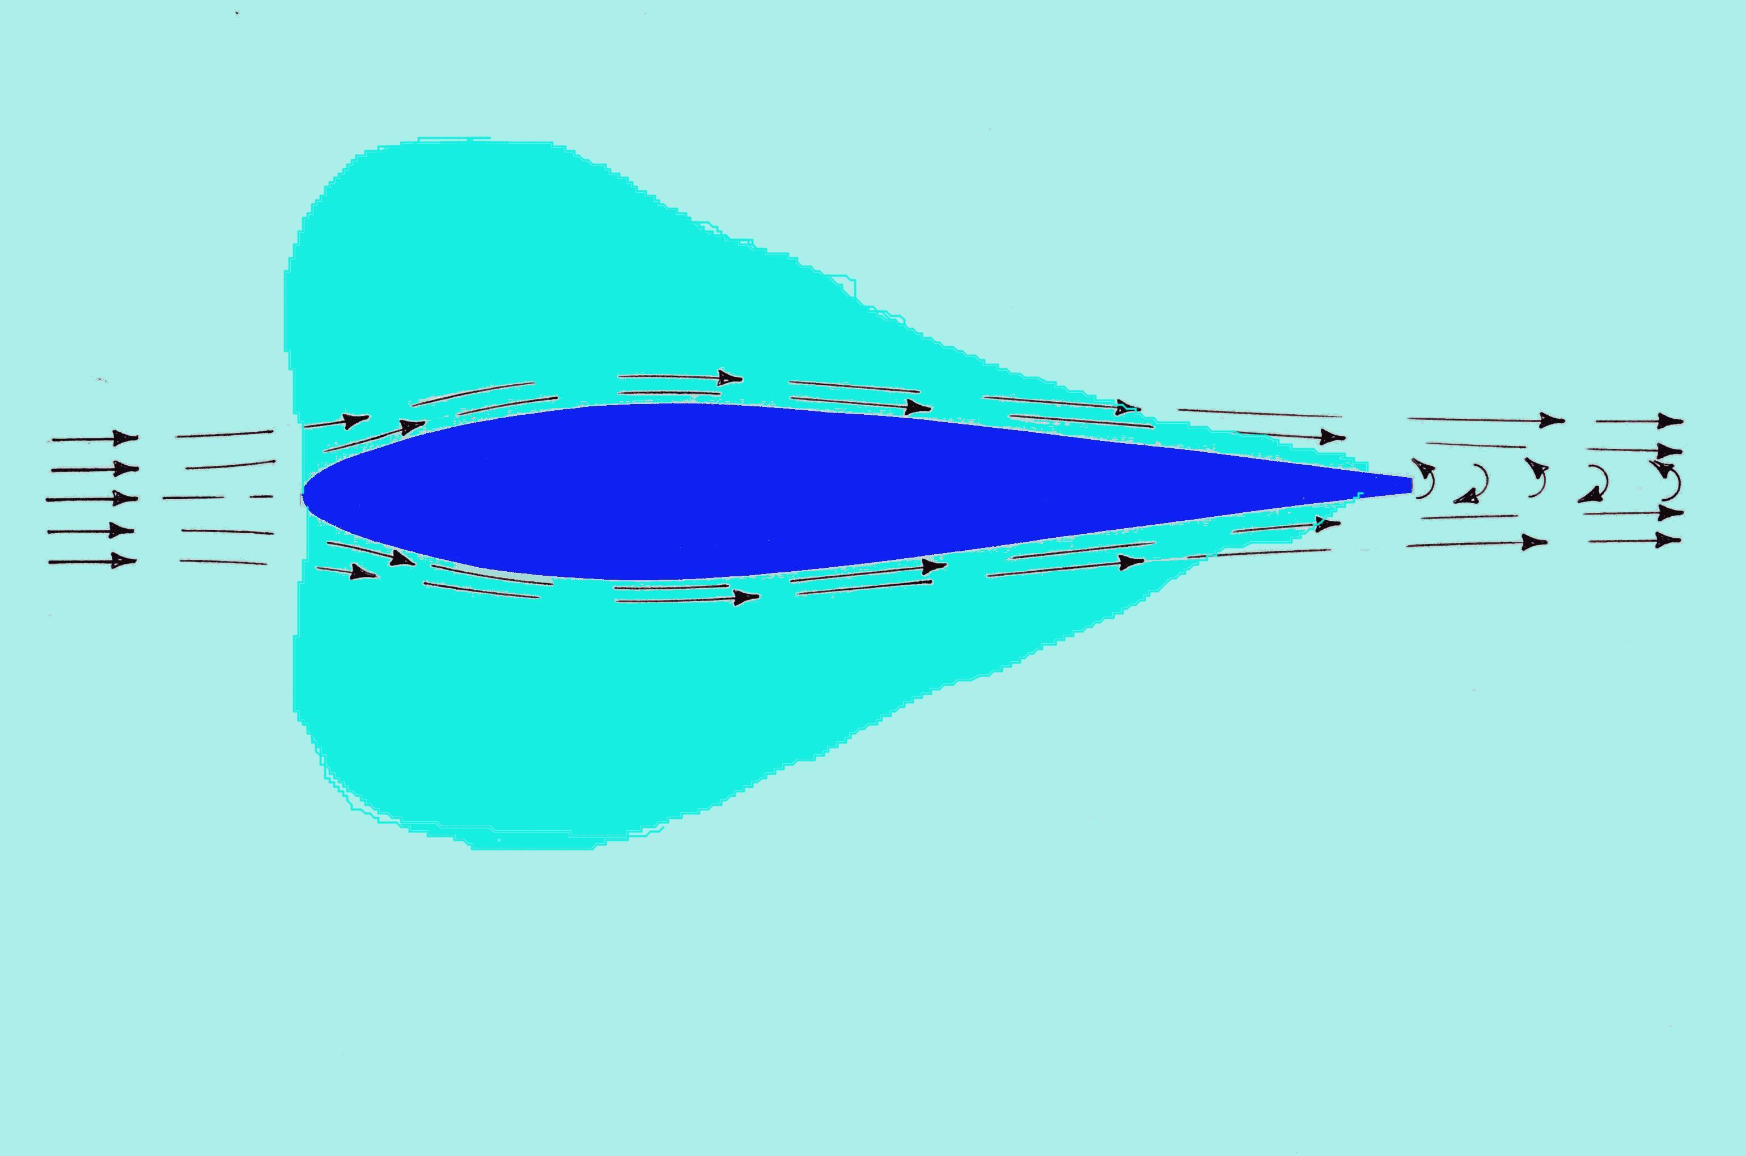
Notes:
When the section is travelling through the air and the aircraft is flying in a straight and level attitude the section develops a lift force equally on both sides. The light blue areas show where the lift is being generated.

Slide 21
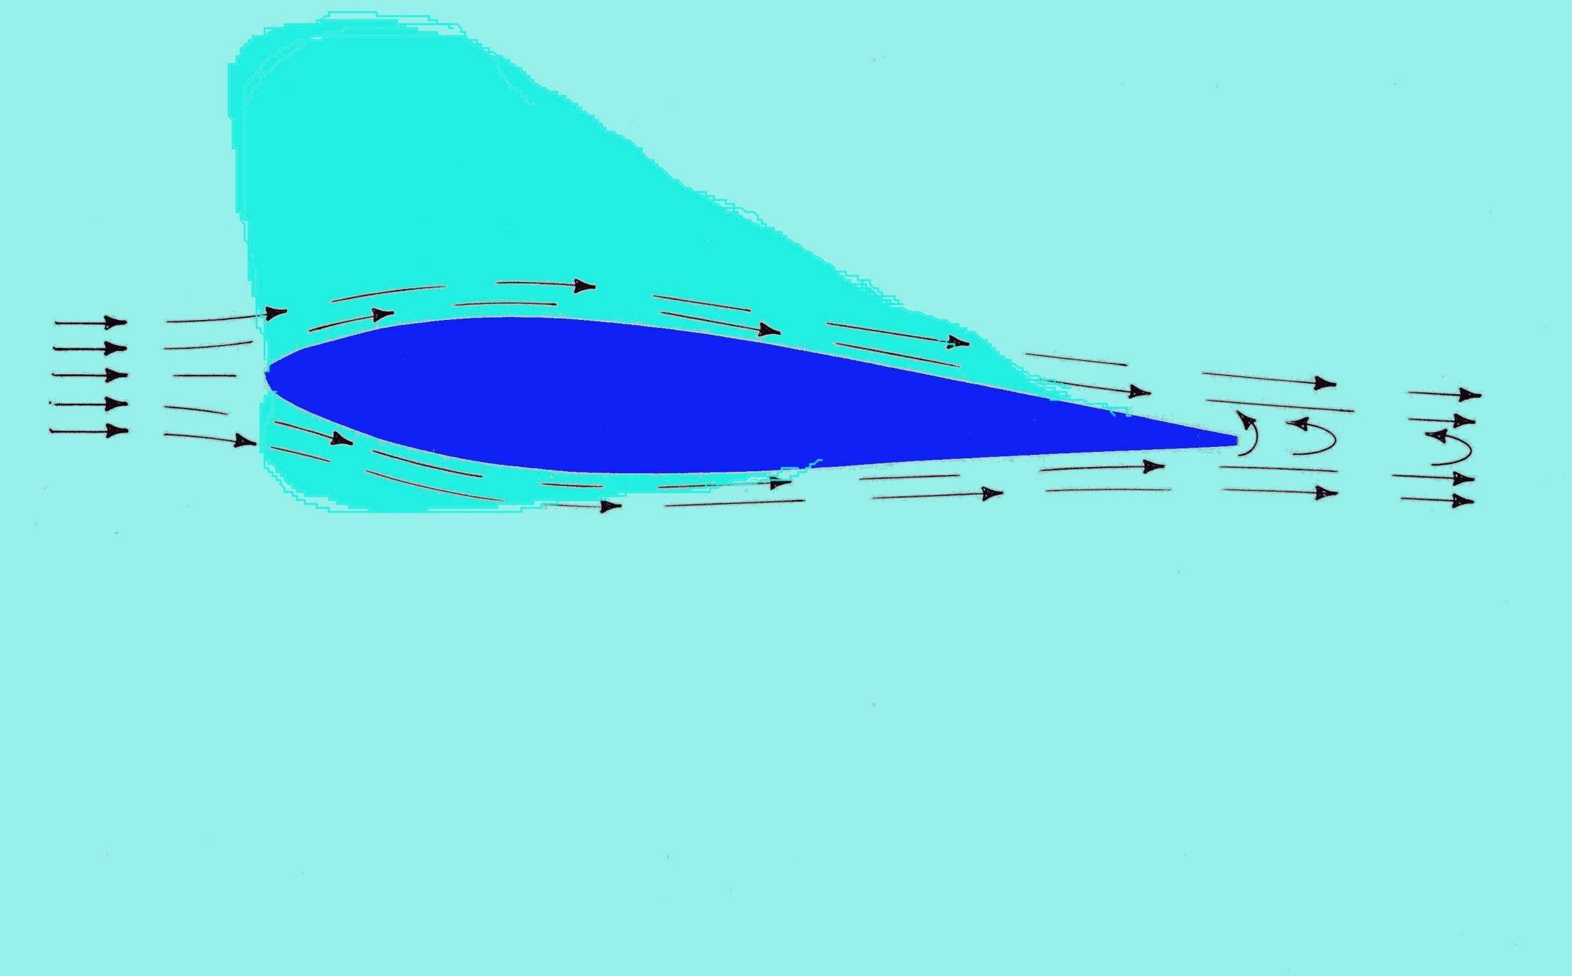
Notes:
If the aircraft is diverted away from the straight and level attitude then, since the section is attached to the aircraft it is forced to travel through the air at an angle. This diagram shows that since the air now has to travel further over the top surface than the bottom surface, more lift is developed on the top rather than the bottom. The light blue areas show how the lift is now unbalanced. The unbalanced lift force will drive the surface upwards and supply the stabilising force to return the aircraft to straight and level flight.

Slide 22
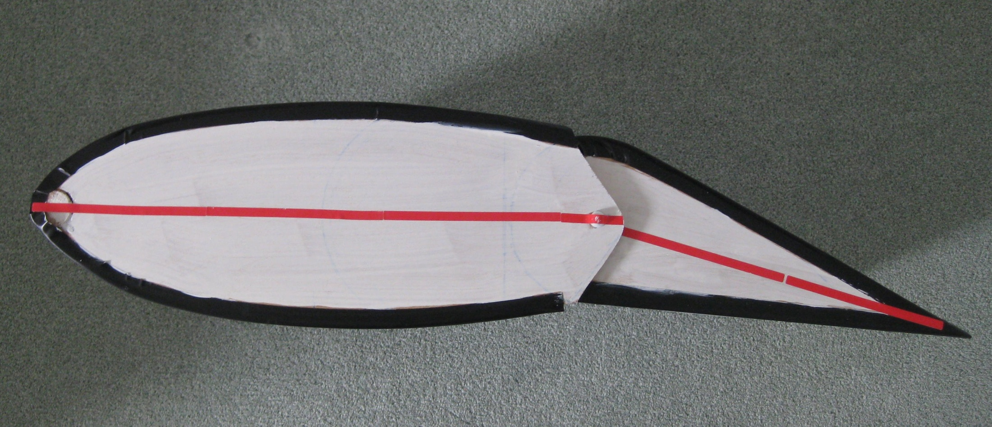
Notes:
If we move the rear hinged part of the surface down, the shape of the stabilising surface changes and the centreline of the surface shown by the red line is now bent similar to the curved centreline that we saw on the wing section. The surface is now cambered. We can now see that the air travelling over the top surface has to speed up twice to get to the trailing edge. Once to travel round the nose of the forward section and secondly to travel round the bend in the section. This double speeding up of the air creates lift in two places and again unbalances the lift force developed by the surface. The effect is to drive the surface upwards and unbalance the whole aircraft. In this case, the tail of the aircraft would be forced up thus forcing the nose of the aircraft down.
The stabilising surface is now acting as a control surface and causing the whole aircraft to change its attitude.

Slide 23
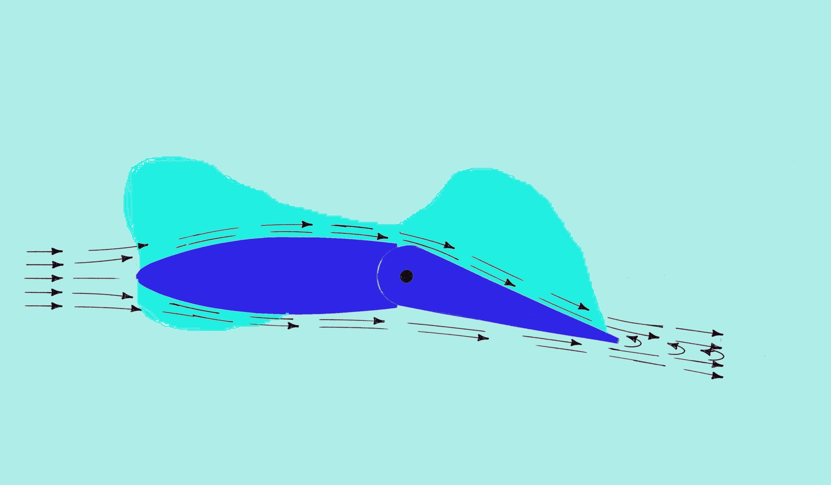
Notes:
This diagram shows how the air travelling across the top of the surface has to speed up twice to get to the trailing edge. The light blue areas show where the lift is developed that unbalances the section.

Slide 24
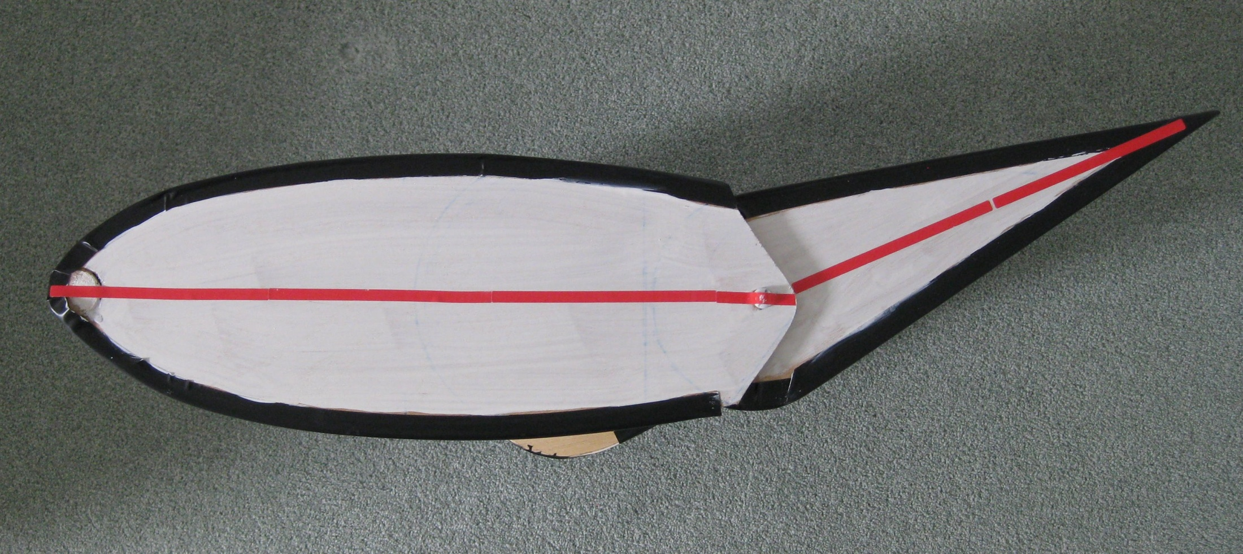
Notes:
This time if we move the rear hinged section upwards the increased lift force will this time be developed on the bottom surface and will unbalance the surface and create a force downwards. The whole surface will now be forced downwards and this will force the tail of the aircraft down and the nose of the aircraft up.

Slide 25
Notes:
So far we have looked at the stabilising and control surface as if it was mounted horizontally on the tail of the aircraft. If we now rotate the surface into the vertical position the effects remain the same but this time instead of pitching the nose of the aircraft up and down, the nose of the aircraft will be yawed to the left and right.
So now we have two surfaces mounted at the rear of the aircraft, one horizontal and the other vertical. We have seen that these two surfaces can stabilise the aircraft to keep it flying level with the nose pointing in a steady direction. Also we have seen that if we change the shape of the section by moving the rear portion we can make the aircraft climb or dive or point the aircraft to the left or right. The normal British names for these surfaces are, tailplane and elevator for the horizontal surfaces and fin and rudder for the vertical surfaces.
This is the French Antionette aircraft that set the standard in 1909. It has vertical surfaces above and below the rear fuselage and a horizontal surface. Note that the hinged control surfaces are quite small and triangular.

Slide 26
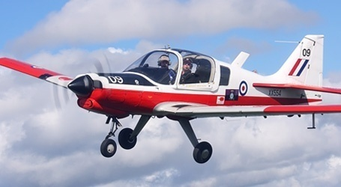
Notes:
The next photos illustrate examples of aircraft that have these type of control surfaces at the rear of the aircraft.
This is the Bulldog, a small training aircraft built at Prestwick. The vertical tail surface shows up well with its relatively large fin and rudder.

Slide 27
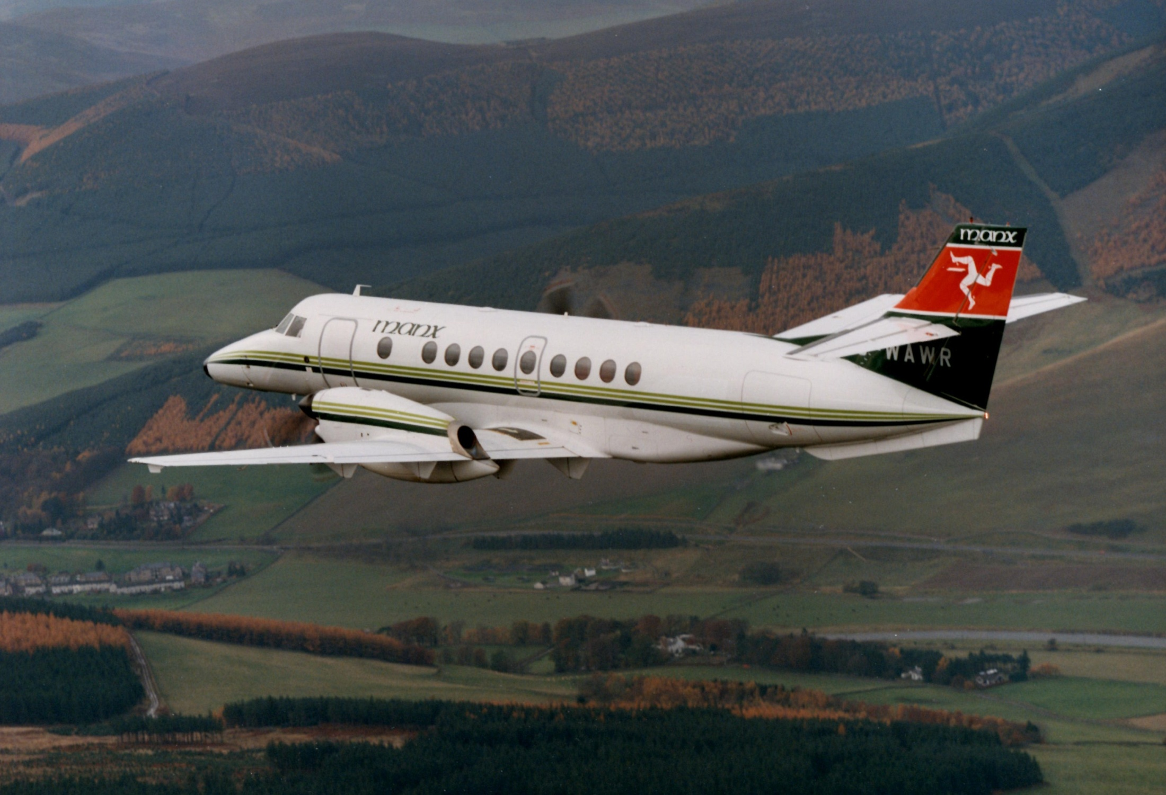
Notes:
This Jetstream 41 aircraft, also built at Prestwick, has its horizontal stabilising surface mounted halfway up the vertical stabilising surface.

Slide 28
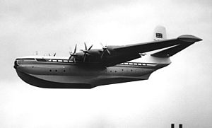
Notes:
This huge Saunders Roe Princess flying boat, built in1952 had very large tail mounted stabilising and control surfaces. The control surfaces were so large that the pilot had to have mechanical assistance to move them, just like the servo assisted steering on modern cars.

Slide 29
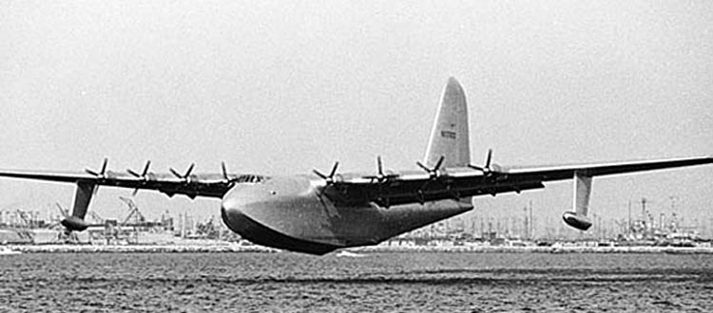
Notes:
The Howard Hughes wooden aircraft. called the Spruce Goose, flew briefly in 1947 and it had very large stabilising surfaces at the rear. This aircraft had a very large wing span. No other aircraft built since that date has ever had a larger wing span.

Slide 30
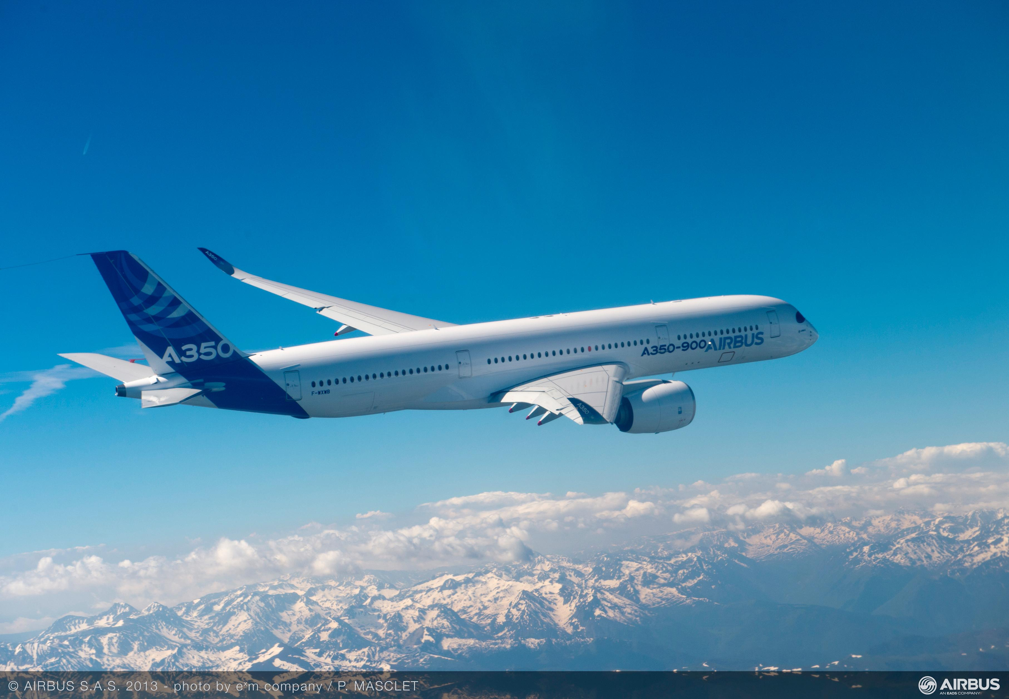
Notes:
This modern Airbus A350 still has the standard layout at the tail but it relies entirely on powered systems to move the control surfaces. The pilot flies the aircraft via computers that continually decide how much to move the surfaces.

Slide 31
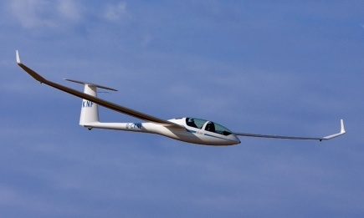
Notes:
This high performance sailplane has the same standard layout with horizontal and vertical stabilisers at the rear.
These type of gliders are the most efficient aircraft ever made by man.
So far we have seen how we can design stabilising and control surfaces that can be used to pitch and yaw the aircraft. We now have to look at the surfaces that can stabilise and control the aircraft in the roll axis and control the direction of flight.
First we can look at how we can stabilise the aircraft in the roll axis. The early pioneers had discovered that if the wings were angled upwards slightly towards the tips, then the wing would automatically return the aircraft to level flight if it was upset in the roll axis. This angle is known as the dihedral angle.
However, we now need control surfaces that can change the stabilising effect of the wing so that we can turn the aircraft to point in a new direction. Although the vertical control surface at the rear of the aircraft is called the rudder it does not steer the aircraft like the rudder on a ship. It is the control surfaces on the wing, called ailerons, that tilt the wing causing the aircraft to roll to left or right and slide round onto a new heading. This is a bit like leaning over on a bike to be able to go round a bend. Aileron is a French word that simply means “a little wing” and they are normally mounted at the trailing edge of the wing near the wing tip.

Slide 32
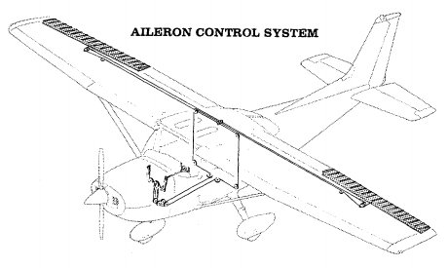
Notes:
Ailerons are quite difficult to design so they can take various forms depending on what the aircraft was designed to do. This diagram shows the ailerons on a typical light aircraft.

Slide 33
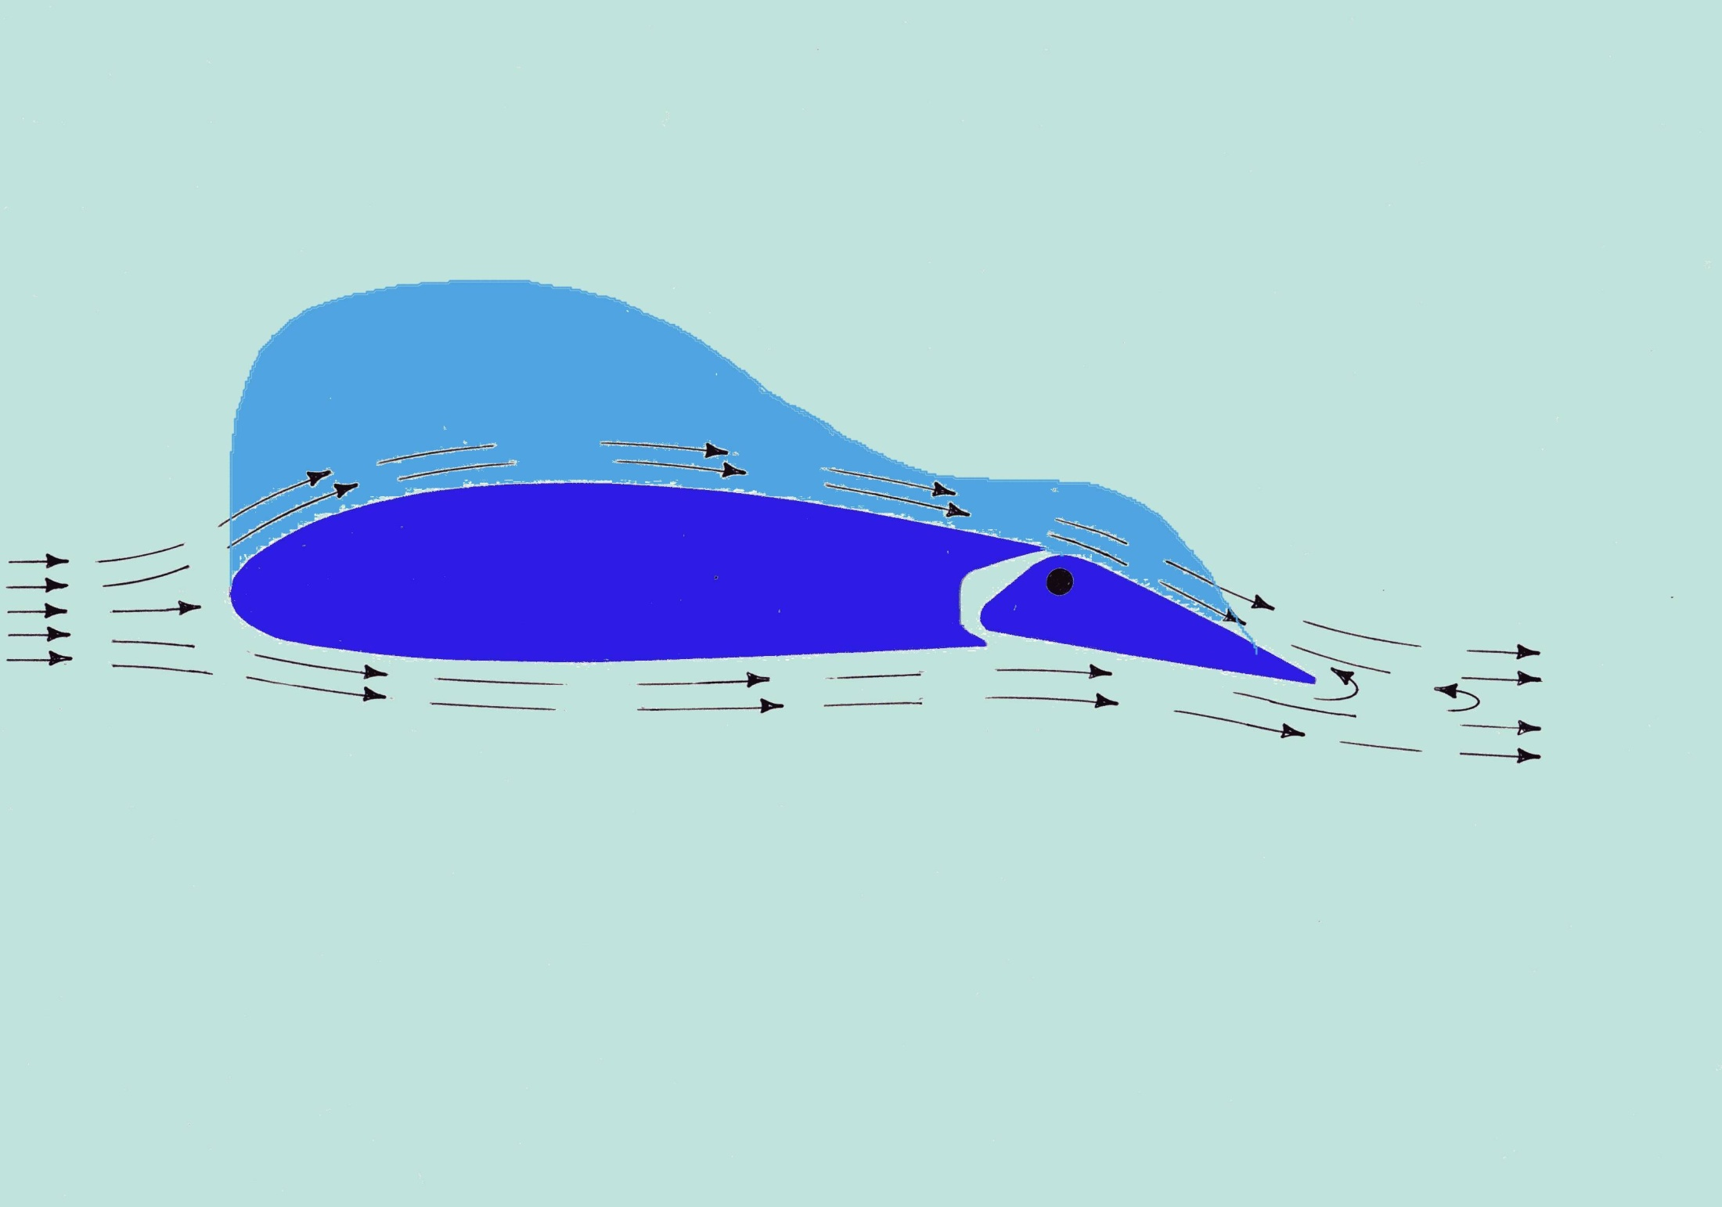
Notes:
This diagram shows what happens when an aileron is deflected down. The air travelling over the top surface of the wing has to speed up to move over the front of the wing but then has to speed up again to follow the upper surface of the aileron. This action causes more lift to be developed over the wing and will causes the wing to rise thus rolling the aircraft. The light blue area shows where the extra lift is developed. The ailerons are usually mounted on the wing near the wing tip.
So now we can see that if an aileron is deflected downwards, the lift developed on the wing increases. This has the effect of lifting the wing and rolling the aircraft. Unfortunately it is not possible to get more lift without increasing the drag and this additional drag tends to yaw the aircraft away from the intended direction of the turn. So there has to be a way of compensating for this. This diagram shows a type of aileron that was designed in the 1930’s by a British aeronautical engineer called Leslie George Frise. This design made the aileron easier to operate and tended to reduce the unwanted adverse yaw.
We now look at what the aileron on the other wing is doing.

Slide 34
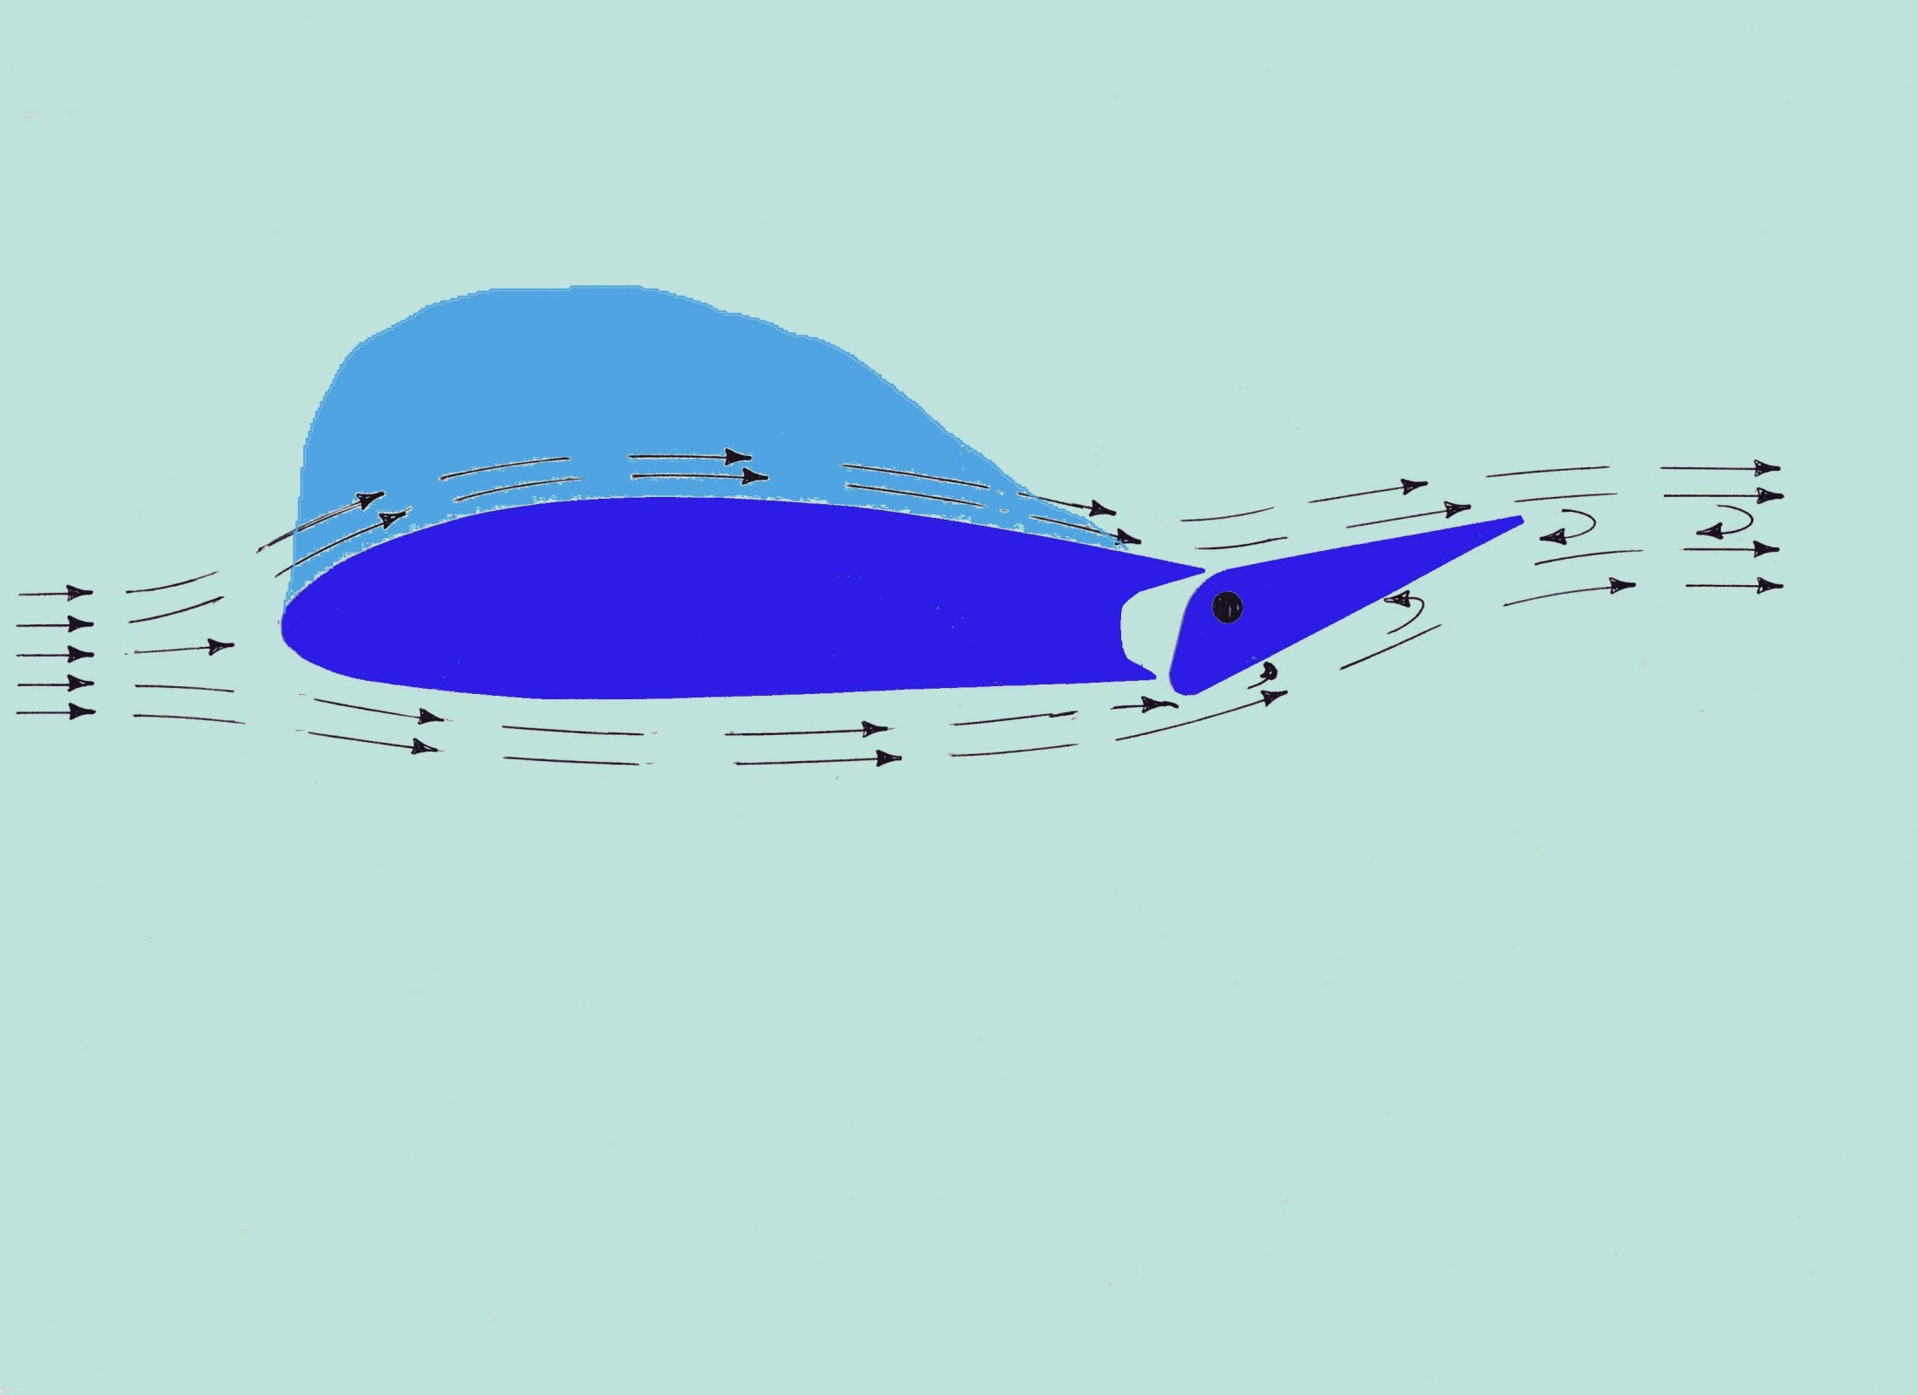
Notes:
The left and right ailerons are connected in such a way that when one goes down other other goes up. This diagram shows what happens when an aileron is moved up. The air travelling over the top surface of the wing now finds that it does not have to move so quickly since the trailing edge is now closer and therefore less lift is developed over the wing. Also the air travelling under the wing meets the relatively sharp corner of the leading edge of the aileron and fails to flow smoothly round the sharp bend. This causes a lot of drag which tends to balance the drag on the other aileron. Also the up-going aileron deflects through a much bigger angle that the down-going aileron. Designers call this a “differential” movement. However, this clever balancing trick sometimes does not quite work so sometimes it is necessary to deflect the rudder slightly to compensate for any error in the differential drag of the ailerons. This ensures a smooth change of direction.

Slide 35
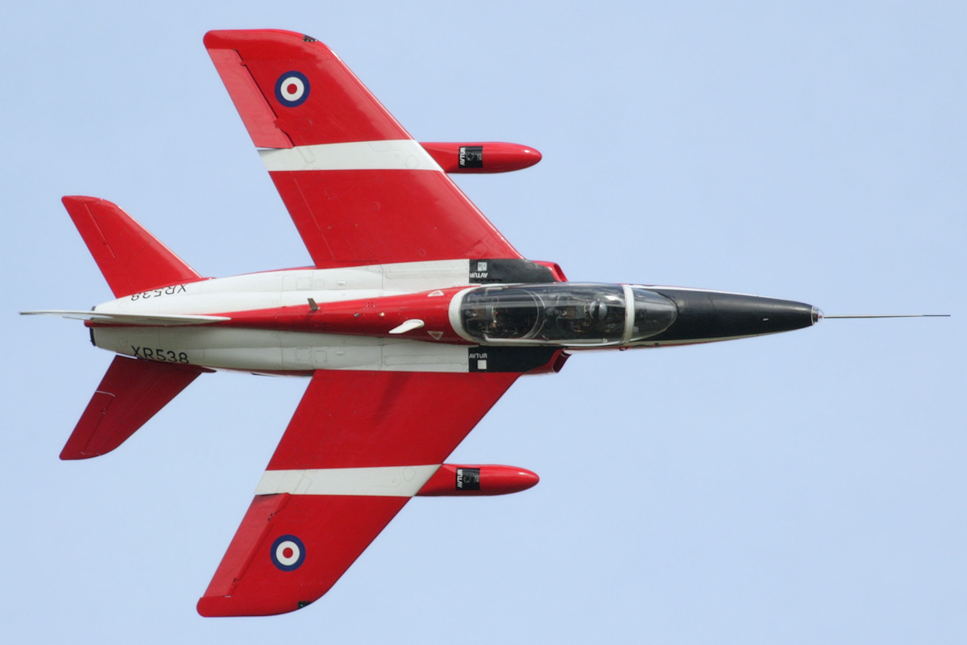
Notes:
This photo shows the ailerons on a small jet engine powered training aircraft. The left aileron is up and the right aileron is down so the aircraft is rolling rapidly to the left.

Slide 36
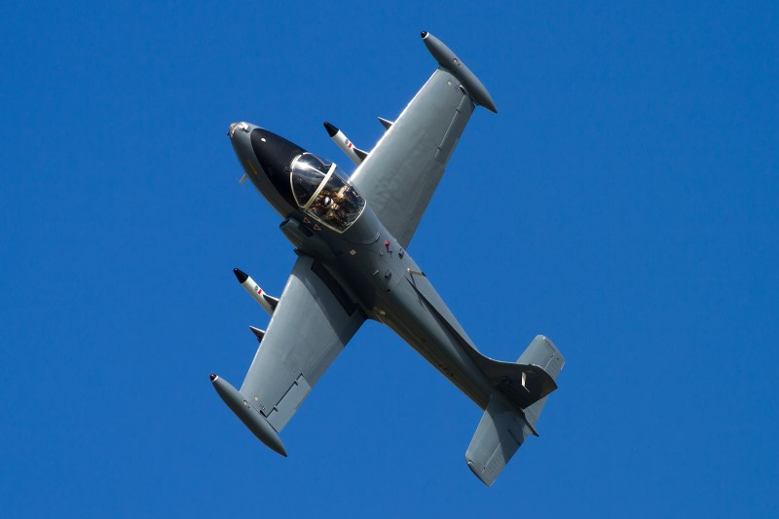
Notes:
This is another training aircraft. By looking at the ailerons, can you tell what the aircraft is doing?

Slide 37
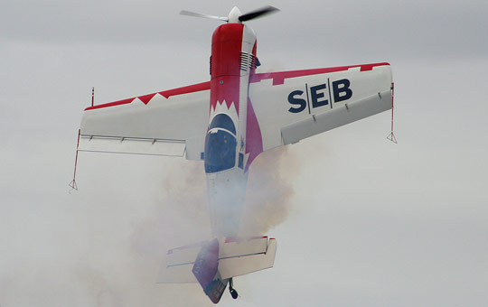
Notes:
This aircraft, with very large ailerons, is designed specifically to be good at aerobatics. This photo shows the aircraft climbing vertically then coming to a stop in mid-air and hanging on its propeller. The engine, running at full power, is turning the propeller in an anti-clockwise direction as a result the engine and the aircraft is being forced to rotate in a clockwise direction. However, the ailerons are working in the slipstream of the propeller and are powerful enough to create a force to stop the aircraft from rotating.

Slide 38
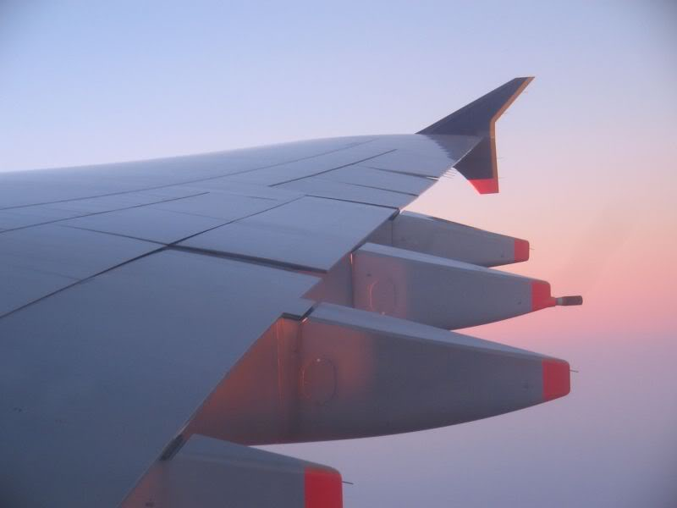
Notes:
The normal aileron of this Airbus A320 is out at the tip of the wing and is mainly used at the slower speeds of take-off and landing. There is also another aileron towards the centre of the wing that is used when cruising at high speed. Both ailerons are shown deflected slightly up so the aircraft is probably turning to the right.
So now we know that by deflecting the ailerons out at the wing tips we can roll the aircraft so that it flies on a curved flight path producing a constantly changing heading until the pilot decides to stop the roll and the aircraft returns to straight and level flight on a new heading.

Slide 39
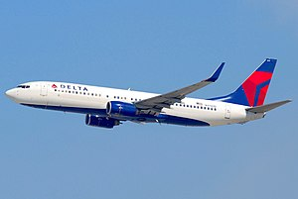
Notes:
This aircraft is the Boeing 737 – 800. You will notice that it has the most common design of aircraft configuration, one that has been proved over the years to be a very efficient way to balance, stabilise and control an aircraft. It has wings at around the centre of the fuselage, stabilising surfaces at the rear of the fuselage and ailerons near the tips of the wings. The next time you fly in an airliner it will most probably look like this.
We have now followed the story of the physics of designing an aircraft that is not only stable but can also be controlled by the pilot.
You will have noticed that some of the photographs of aircraft used to show how the flight control surfaces work, also have engines of some sort. However, our exploration of flight stability and flight controls so far assumed that the aircraft were unpowered gliders. The paper models that we have built were also gliders. These stable and controllable aircraft have only been able to fly downhill because they had to use the force of gravity to produce the thrust to overcome the aerodynamic drag. So our aircraft are not going to be very good at taking us anywhere other than downhill to land not very far away.
The next part of the story shows how designers found ways to develop thrust to allow aircraft to be able to take-off, climb and cruise at a constant height rather than always flying downhill. The next story, “Power for Flight”, takes us through more than one hundred years of development to produce engines for modern aircraft.

